Slide 1

MACHINE LEARNING
Er. Aarti Sharma
Associate Professor
Department : CSE

Slide 2
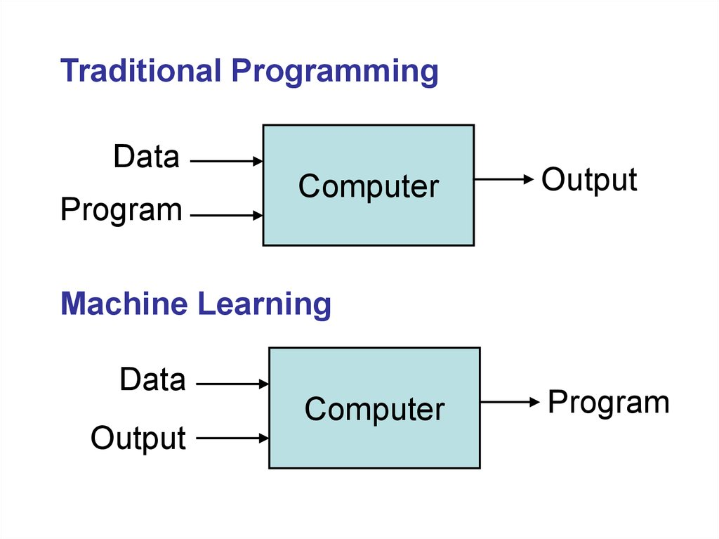
Traditional Algorithm Vs Machine Learning

Slide 3
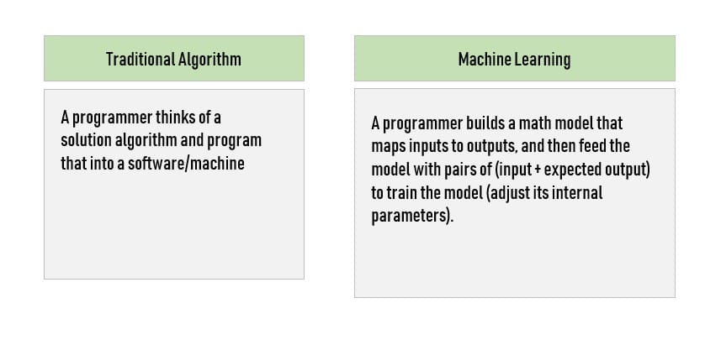

Slide 4
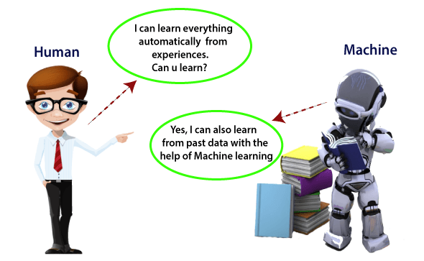
What is Machine Learning
In the real world, humans who can learn everything from their experiences with their learning capability
computers or machines which work on our instructions. But can a machine also learn from experiences or past data like a human does?
Machine Learning is said as a subset of artificial intelligence that is mainly concerned with the development of algorithms which allow a computer to learn from the data and past experiences on their own.
According to Arthur Samuel in 1959 stated that
“it gives computers the ability to learn without being explicitly programmed”.
1997, Tom Mitchell gave a “well-posed” mathematical and relational definition that
“A computer program is said to learn from experience E with respect to some task T and some performance measure P, if its performance on T, as measured by P, improves with experience E.”

Slide 5
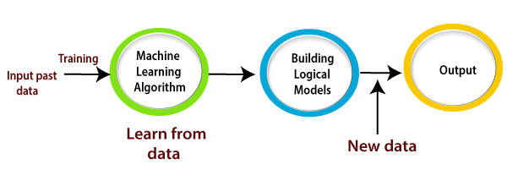
How does Machine Learning work
A Machine Learning system learns from historical data, builds the prediction models, and whenever it receives new data, predicts the output for it.
Suppose we have a complex problem, where we need to perform some predictions, so instead of writing a code for it, we just need to feed the data to generic algorithms, and with the help of these algorithms, machine builds the logic as per the data and predict the output.

Slide 6
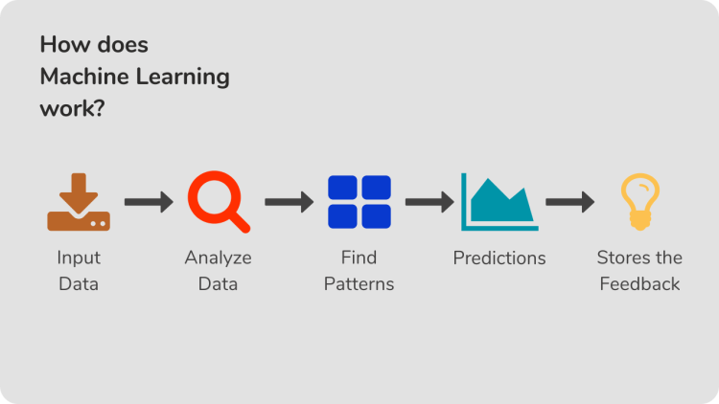

Slide 7
Features of Machine Learning:
Machine learning uses data to detect various patterns in a given dataset.
It can learn from past data and improve automatically.
It is a data-driven technology.
Machine learning is much similar to data mining as it also deals with the huge amount of the data.
The importance of Machine Learning:
Rapid increment in the production of data
Solving complex problems, which are difficult for a human
Decision making in various sector including finance
Finding hidden patterns and extracting useful information from data.

Slide 8
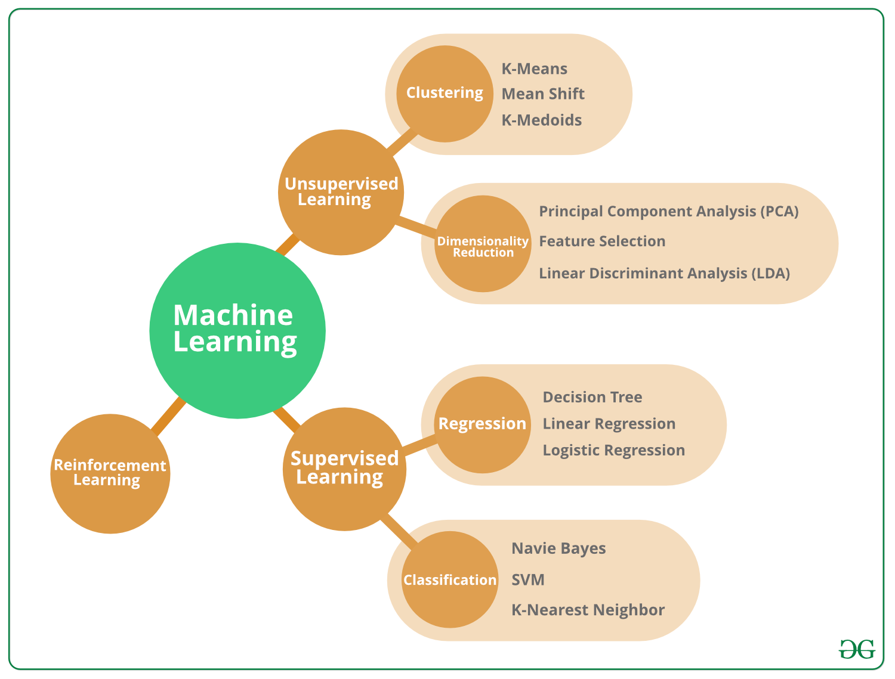
Types of Machine Learning

Slide 9
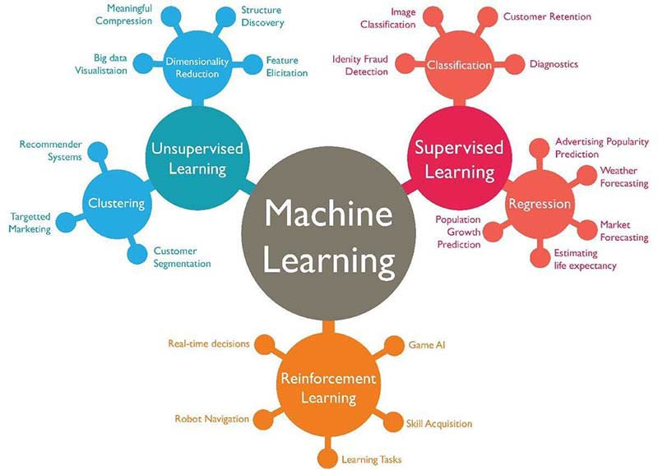
Applications of Machine learning

Slide 10
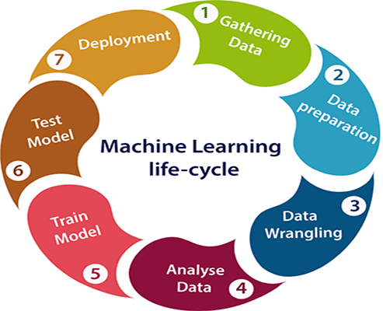
Machine learning Life cycle

Slide 11
Difference between Artificial intelligence and Machine learning
AI: AI is a bigger concept to create intelligent machines that can simulate human thinking capability and behavior, whereas, machine learning is an application or subset of AI that allows machines to learn from data without being programmed explicitly.
ML: Machine learning is a subfield of artificial intelligence, which enables machines to learn from past data or experiences without being explicitly programmed.

Slide 12
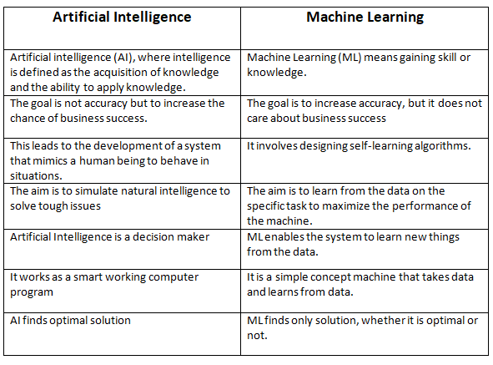
Difference between Artificial intelligence and Machine learning

Slide 13
What is Learning?
A way of making a computer to learn and act like humans by feeding data and information without being explicitly programmed.
Basically we can say that machine learning is subset of AI.
There are 3 types of learning:
Supervised Learning
Unsupervised Learning
Reinforcement Learning

Slide 14
What is Supervised Learning?
In Supervised learning, you can teach the machine using data which is well "labeled."
It means some data is already tagged with the correct answer. It can be compared to learning which takes place in the presence of a supervisor or a teacher.
A supervised learning algorithm learns from labeled training data, helps you to predict outcomes for unforeseen data.
Expert Team or Data scientist are required to successfully build supervised model.

Slide 15
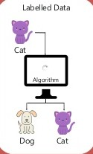
What is a Labeled Data Set?
The data set with output for a given input is called a Labeled Dataset.
For example:

Slide 16
Why Supervised Learning?
Supervised learning allows you to collect data or produce a data output from the previous experience.
Helps you to optimize performance criteria using experience
Supervised learning helps you to solve various types of real-world computation problems.
It is a fast learning mechanism with high accuracy.

Slide 17
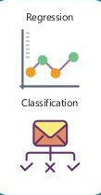
Problem Type?
Supervised Learning problem include:
Regression problem
Classification problem

Slide 18
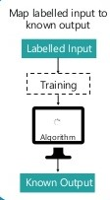
Approach of Supervised Learning

Slide 19
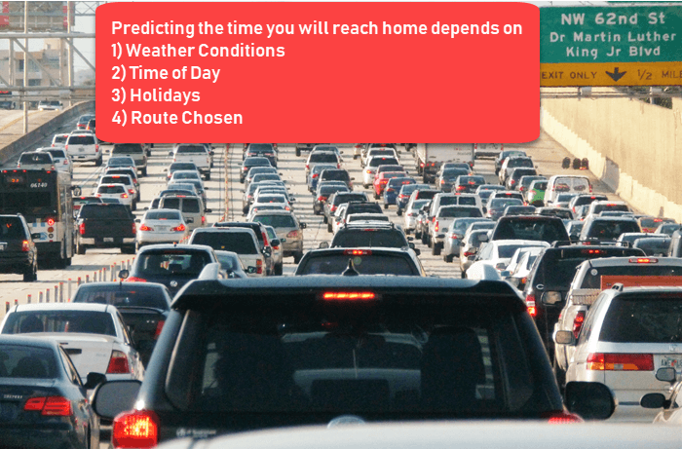
How Supervised Learning Works?

Slide 20
For example, if you want to train a machine to help you predict how long it will take us to drive home from your workplace. We start by creating a set of labeled data. This data includes
Weather conditions
Time of the day
Holidays
All these details are our inputs. The output is the amount of time it took to drive back home on that specific day.

Slide 21
First Case: If it is raining outside, then it will take larger time or not.
Second Case: if we get out at 6p.m to get home will take larger time or not

Slide 22
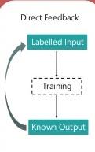
Output feedback of Supervised Learning

Slide 23
Some Popular Algorithms of Supervised Learning
Linear Regression
Decision Trees
K- Nearest Neighbor
Support Vector Machine
Neural Networks

Slide 24
Some Applications
Fraud Detection
Risk evaluation
Forecast sales
Loan approval or rejection

Slide 25
What is Unsupervised Learning?
In Unsupervised learning technique, you do not need to supervise the model.
Instead, you need to allow the model to work on its own to discover information.
It mainly deals with the unlabelled data.
Unsupervised learning algorithms allow you to perform more complex processing tasks compared to supervised learning.
Although, unsupervised learning can be more unpredictable as compared to other learning methods.
Unsupervised learning is computationally more complex.

Slide 26
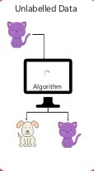
What is a Unlabeled Data Set?
The data set with unknown output values for all input values is called a Unlabeled Dataset.
For example:

Slide 27
Why Unsupervised Learning?
There, are some prime reasons for using Unsupervised Learning:
Unsupervised method finds all kind of unknown patterns in data.
It help you to find features which can be useful for categorization.
It is taken place in real time, so all the input data to be analyzed and labeled in the presence of learners.
It is easier to get unlabeled data from a computer than labeled data, which needs manual intervention.

Slide 28
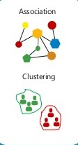
Types of Unsupervised Learning Techniques
Unsupervised Learning problem further grouped into:
Clustering .
Eg. Telecom company
Association.
Eg. Supper Market

Slide 29
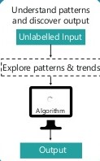
Approach of Unsupervised Learning

Slide 30
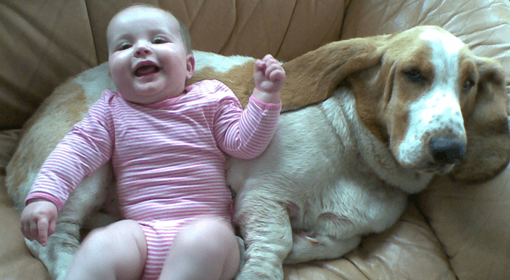

How Unsupervised Learning Works?
Let's, take the case of a baby and her family dog.
A new dog:

Slide 31
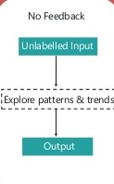
Output feedback of Unsupervised Learning

Slide 32

Some Unsupervised Learning Algorithms
Unsupervised algorithms can be divided into different categories like:
Cluster algorithms,
K-means clustering,
Hierarchical clustering,
Apriori Algorithm etc.

Slide 33
Some Applications Areas
Recommendation system
Anomaly detection
Market Basket Analysis, …etc

Slide 34
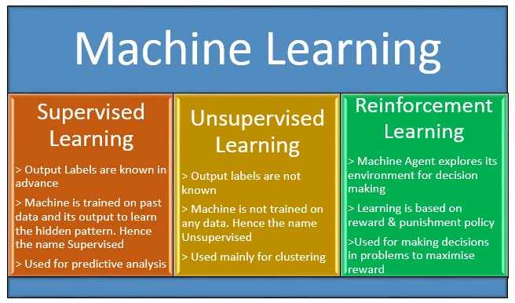
Classification of Machine Learning

Slide 35
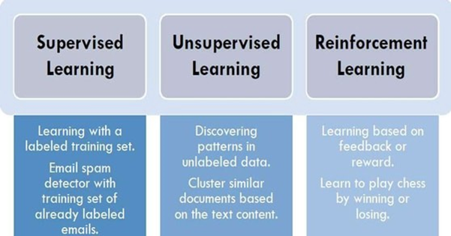

Slide 36
THANK YOU !

